Slide 1
Chapter 12. Multiple Access
Random Access
Controlled Access
Channelization

Slide 2

Data Link Layer: Two sublayers
Data link layer divided into two functionality-oriented sublayers
IEEE made this division for LANs

Slide 3

Medium Access Protocols

Slide 4
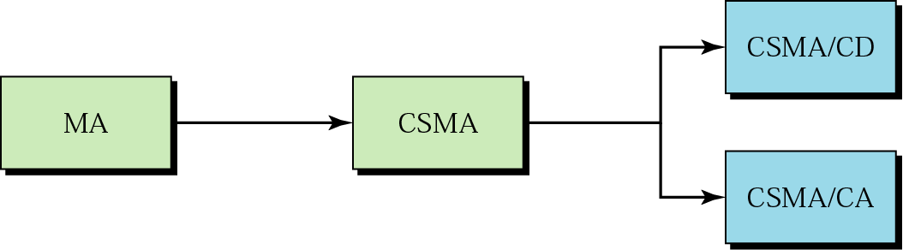
Random Access
Each station has the right to the medium without being controlled by any other station
Collision, a access conflict, if more than one station tries to send

Slide 5

ALOHA
The earliest random access method developed at the Univ. of Hawaii in the early 1970s
Designed for a radio (wireless) LAN
Pure ALOHA and Slotted ALOHA
Frames in a pure ALOHA network

Slide 6

Pure ALOHA Protocol: Procedure
Binary exponential back-off algorithm

Slide 7

Pure ALOHA Protocol
Pure ALOHA vulnerable time = 2 x T_{fr}
The throughput for pure ALOHA is S = G × e ^{−2G} .
The maximum throughput S_{max} = 0.184 when G= (1/2).

Slide 8

Slotted ALOHA
Pure ALOHA vulnerable time = 2 x T_{fr} because there is no rule that defines when the station can send
Slotted ALOHA was invented to improve the efficiency of pure ALOHA

Slide 9

Slotted ALOHA
throughput for slotted ALOHA is S = G × e^{−G} .
The maximum throughput S_{max} = 0.368 when G = 1
Slotted ALOHA vulnerable time = T_{fr}

Slide 10

Carrier Sense Multiple Access (CSMA)
CSMA
  “Sense before transmit”
  “Listen before talk”
CSMA can reduce the possibility of collision, but it can not eliminate it

Slide 11
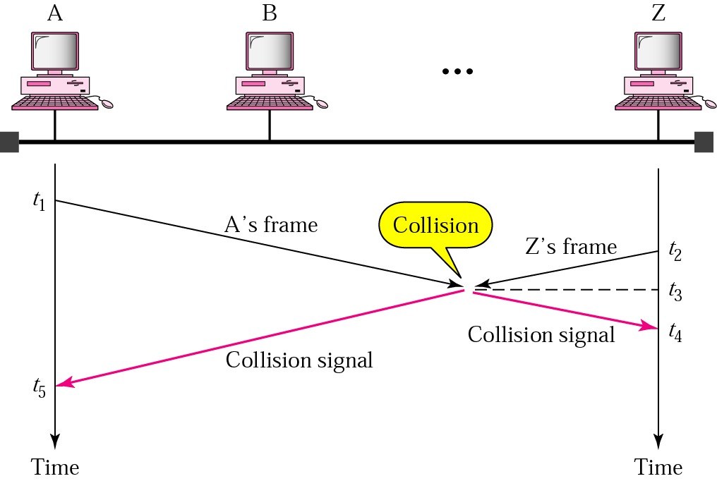
Collision in CSMA

Slide 12

CSMA: Vulnerable Time
Vulnerable time for CSMA is the propagation time T_{p} needed for a signal to propagate from one end of the medium to the other

Slide 13

CSMA: Persistence Methods
Behavior of 1-persistent, Nonpersistent, p-persistent method

Slide 14

CSMA: Persistence Methods
Flow diagram for 1-persistent, Nonpersistent, p-persistent method

Slide 15
Persistence Strategy
Nonpersistent strategy
  Reduces the chance of collision
  Reduces the efficiency of the network
1-persistent
  Increases the chance of collision
p-persistent
  Reduces the chance of collision and improves the efficiency by combining the other two strategies.

Slide 16


CSMA/CD (Collision Detection)

Slide 17
CSMA/CD: Min. Frame Size
Example: A network using CSMA/CD has a bandwidth of 10 Mbps. If the maximum propagation time (including the delays in the devices and ignoring the time needed to send a jamming signal, as we see later) is 25.6 μs, what is the minimum size of the frame?
Solution
The frame transmission time is T_{fr} = 2 × T_{p} = 51.2 μs. This means, in the worst case, a station needs to transmit for a period of 51.2 μs to detect the collision. The minimum size of the frame is 10 Mbps × 51.2 μs = 512 bits or 64 bytes. This is actually the minimum size of the frame for Standard Ethernet.

Slide 18

CSMA/CD: Flow Diagram

Slide 19

CSMA/CD: Energy Level & Throughput
Energy level during transmission, idleness, or collision
Throughput of CSMA/CD is greater than that of ALOHA
The max. throughput occurs at a different value of G and is based on the persistent method and the value of p in the p-persistent approach
The max throughput is around 50% when G=1 for 1-persistent, up to 90% when G is between 3 and 8 for non-persistent

Slide 20

CSMA/CA (Collision Avoidance)
Invented for wireless network where we cannot detect collisions
Collision are avoided through the use of CSMA/CA’s three strategies: the interframe space, the contention windows, and acknowledgement
IFS can also be used to define the priority of a station or a frame
If the station finds the channel busy, it does not restart the timer of the contention window; it stops the timer and restarts it when the channel becomes idle

Slide 21

CSMA/CA: Flow Diagram

Slide 22

Controlled Access
The stations consult one another to find which station has the right to send
Reservation/Polling/ Token passing
Reservation access method

Slide 23

Polling: Select and Poll Functions

Slide 24

Token Passing
Logical Ring and physical topology

Slide 25

Channelization: FDMA
FDMA
  Available bandwidth of the common channel is divided into bands that are separated by guard bands
  FDMA is an access method in data link layer protocol. But, FDM is a physical layer technique

Slide 26

Channelization: TDMA
TDMA
  The bandwidth is just one channel that is timeshared between different stations
  TDMA is an access method. But, TDM is a physical layer technique

Slide 27

Channelization: CDMA
One channel carries all transmissions simultaneously
Two properties: If we multiply each code by another, we get 0. If we multiply each code by itself, we get 4
Data = (d₁.c₁ + d₂.c₂ + d₃.c₃ + d₄.c₄) .c₁
    = d₁.c₁.c₁ + d₂.c₂.c₁ + d₃.c₃.c₁ + d₄.c₄.c₁ = 4.d₁

Slide 28
CDMA: Chips
Sequence of numbers called chips
Orthogonal sequences have the following properties:
  Each sequence is made of N elements, where N is the number of stations
  If we multiply a sequence by a number, every element in the sequence is multiplied by that element (scalar multiplication)
  If we multiply two equal sequence, element by element, and add the results, we get N (inner product)
  If we multiply two different sequence, element by element, and add the results, we get 0
  Adding two sequence means adding the corresponding elements. The result is another sequence
Data representation in CDMA

Slide 29

CDMA: Encoding and Decoding
Show how four stations share the link during a 1-bit interval

Slide 30

CDMA: Signal Level
Digital signal created by four stations in CDMA using NRZ-L for simplicity

Slide 31

CDMA: Decoding
Show how station 3 can detect the data by station 2 by using the code for station 2
Decoding of the composite signal for one in CDMA

Slide 32

CDMA: Sequence Generation
To generate chip sequence, we use a Walsh table
The number of sequence in a Walsh table needs to be N = 2^{m}

Slide 33
Sequence Generation: Example
Find the chips for a network with
a. Two stations b. Four stations
Solution
a. For a two-station network, we have
[+1 +1] and [+1 −1].
b. For a four-station network we have
[+1 +1 +1 +1], [+1 −1 +1 −1],
[+1 +1 −1 −1], and [+1 −1 −1 +1].

